Slide 1


HEP NTUA Weekly Report 17/3/2021
George Bakas

Slide 2
Summary
ttX analysis:
Removed geometrical matching from files
Chain of analysis completed
Integrated angular variables
I managed to apply combination of results
Comparison with Giannis
Particle level also
Looking into results without matching
Z’ analysis
Switch to UL files for Z’ (missing: 2016_postVFP (all widths) and 2016_preVFP, 2017, 2018 10% and 30% width files)
Email to B2G MC generation group
Production of 1200, 1400, 1600 and 1800 GeV Masses
mJJ cut is now 1 TeV as in the ttX analysis
Calculation of XSEC using GenXSecAnalyzer
Results (work in progress, something is not looking good)
1% width: (dataset name: ZPrimeToTT_M*_TuneCP2_13TeV-madgraph-pythia8) 2016 B2G-2020Nov18-00005 17 samples Submitted Ongoing 2016APVB2G-2020Nov18-00006 17 samples Submitted DONE 2017 B2G-2020Nov18-00007 10 samples Submitted DONE 2018 B2G-2020Nov18-00008 10 samples Submitted DONE 10% and 30% width: (dataset name: ZPrimeToTT_M*_TuneCP2_13TeV-madgraph-pythia8) 2016 B2G-2021Feb17-00002 34 samples Submitted Ongoing 2016 APV B2G-2021Feb17-00004 34 samples Submitted Ongoing 2016 B2G-2021Feb17-00006 34 samples Submitted Ongoing 2016 B2G-2021Feb17-00008 34 samples Submitted Ongoing

Slide 3
BACKUP

Slide 4
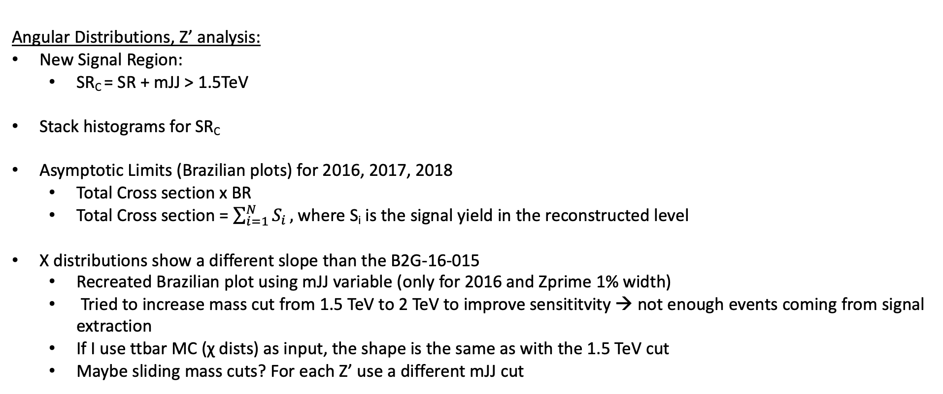
Summary
Angular Distributions, Z’ analysis:
New Signal Region:
SR_{C} = SR + mJJ > 1.5TeV
Stack histograms for SR_{C}
Asymptotic Limits (Brazilian plots) for 2016, 2017, 2018
Total Cross section x BR
Total Cross section = $\sum_{i=1}^{N}{S_{i}},$where S_{i} is the signal yield in the reconstructed level
Χ distributions show a different slope than the B2G-16-015
Recreated Brazilian plot using mJJ variable (only for 2016 and Zprime 1% width)
Tried to increase mass cut from 1.5 TeV to 2 TeV to improve sensititvity → not enough events coming from signal extraction
If I use ttbar MC (χ dists) as input, the shape is the same as with the 1.5 TeV cut
Maybe sliding mass cuts? For each Z’ use a different mJJ cut

Slide 5
Signal Selection
Control Region Selection
Variables | Selected Cut
pT (both leading jets) | > 400 GeV
Njets | > 1
N leptons | = 0
|eta| (both leading jets) | < 2.4
mJJ | > 1000 GeV
jetMassSoftDrop (only for fit) | (50,300) GeV
Top Tagger | > 0.2, 0, 0.1
B tagging (2 btagged jets) | > Medium WP
Signal Trigger
Variables | Selected Cut
pT (both leading jets) | > 400 GeV
Njets | > 1
N leptons | = 0
|eta| (both leading jets) | < 2.4
mJJ | > 1000 GeV
jetMassSoftDrop (only for fit) | (50,300) GeV
Top Tagger | > 0.2, 0, 0.1
B tagging (0 btagged jets) | < Medium WP
Control Trigger

Slide 6
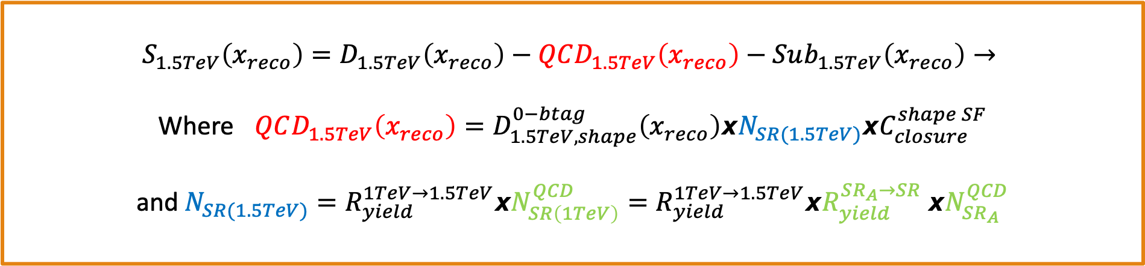
Signal Extraction
$$S_{1.5TeV}\left(x_{reco}\right)=D_{1.5TeV}\left(x_{reco}\right)−QCD_{1.5TeV}\left(x_{reco}\right)−Sub_{1.5TeV}\left(x_{reco}\right)→$$
Where $QCD_{1.5TeV}\left(x_{reco}\right)=D_{1.5TeV, shape}^{0−btag}\left(x_{reco}\right)xN_{SR(1.5TeV)}{xC}_{closure}^{shape SF}$
and $N_{SR(1.5TeV)}=R_{yield}^{1TeV→1.5TeV}xN_{SR\left(1TeV\right)}^{QCD}=R_{yield}^{1TeV→1.5TeV}xR_{yield}^{SR_{A}→SR} {xN}_{SR_{A}}^{QCD}$
The variable of interest here: x_{reco} → χ
1.5 TeV refers to the mJJ cut
We deploy a fit in the Signal Region (2btag) to extract the $N_{QCD}^{fit}$ in SRA (mJJ > 1TeV)
$$D{\left(m^{t}\right)}^{(i)}=N_{tt}^{(i)}T^{(i)}\left(m^{t},k_{MassScale}, k_{MassResolution}\right)+N_{bkg}^{(i)}B\left(m^{t} \right)\left(1+k_{1}x\right)+N_{sub}^{(i)}O^{(i)}\left(m^{t}\right)$$

Slide 7
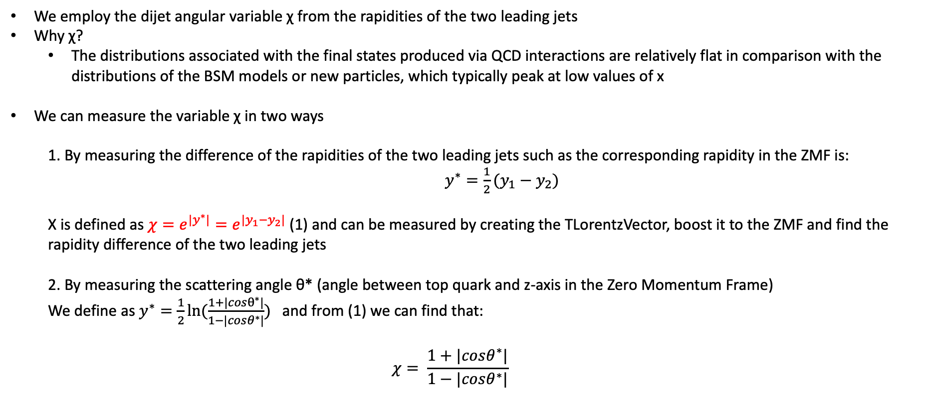
Top Angular Distributions
We employ the dijet angular variable χ from the rapidities of the two leading jets
Why χ?
The distributions associated with the final states produced via QCD interactions are relatively flat in comparison with the distributions of the BSM models or new particles, which typically peak at low values of x
We can measure the variable χ in two ways
1. By measuring the difference of the rapidities of the two leading jets such as the corresponding rapidity in the ZMF is: $y^{∗}=\frac{1}{2}(y_{1}−y_{2})$
Χ is defined as $χ=e^{{|y}^{∗}|}=e^{|y_{1}−y_{2}|}$ (1) and can be measured by creating the TLorentzVector, boost it to the ZMF and find the rapidity difference of the two leading jets
2. By measuring the scattering angle θ* (angle between top quark and z-axis in the Zero Momentum Frame)
We define as $y^{∗}=\frac{1}{2}ln⁡(\frac{1+|cosθ^{∗}|}{1−|cosθ^{∗}|})$ and from (1) we can find that:
$$χ= \frac{1+|cosθ^{∗}|}{1−|cosθ^{∗}|}$$

